Slide 1
CHAPTER 6
GRAPHS
All the programs in this file are selected from
Ellis Horowitz, Sartaj Sahni, and Susan Anderson-Freed
“Fundamentals of Data Structures in C”,
Computer Science Press, 1992.
CHAPTER 6

Slide 2
Definition
A graph, G=(V, E), consists of two sets:
  a finite set of vertices(V), and
  a finite, possibly empty set of edges(E)
  V(G) and E(G) represent the sets of vertices and edges of G, respectively
Undirected graph
  The pairs of vertices representing any edges is unordered
  e.g., (v₀, v₁) and (v₁, v₀) represent the same edge
Directed graph
  Each edge as a directed pair of vertices
  e.g. <v₀, v₁> represents an edge, v₀ is the tail and v₁ is the head
(v0, v1) = (v1,v0)
<v0, v1> != <v1,v0>
CHAPTER 6

Slide 3
Examples for Graph
0
0
0
1
2
1
2
1
3
3
4
5
6
G1
2
G2
complete graph
incomplete graph
G3
V(G1)={0,1,2,3} E(G1)={(0,1),(0,2),(0,3),(1,2),(1,3),(2,3)}
V(G2)={0,1,2,3,4,5,6} E(G2)={(0,1),(0,2),(1,3),(1,4),(2,5),(2,6)}
V(G3)={0,1,2} E(G3)={<0,1>,<1,0>,<1,2>}
complete undirected graph: n(n-1)/2 edges
complete directed graph: n(n-1) edges
CHAPTER 6

Slide 4
Complete Graph
A complete graph is a graph that has the
maximum number of edges
  for undirected graph with n vertices, the maximum number of edges is n(n-1)/2
  for directed graph with n vertices, the maximum
  number of edges is n(n-1)
  example: G1 is a complete graph
CHAPTER 6

Slide 5
Adjacent and Incident
If (v0, v1) is an edge in an undirected graph,
  v0 and v1 are adjacent
  The edge (v0, v1) is incident on vertices v0 and v1
If <v0, v1> is an edge in a directed graph
  v0 is adjacent to v1, and v1 is adjacent from v0
  The edge <v0, v1> is incident on v0 and v1
CHAPTER 6

Slide 6
Figure 6.3
*Figure 6.3:Example of a graph with feedback loops and a
multigraph (p.260)
0
0
2
1
3
1
2
self edge
multigraph:
multiple occurrences
of the same edge
(a)
(b)
CHAPTER 6

Slide 7
Subgraph and Path
A subgraph of G is a graph G’ such that V(G’)
is a subset of V(G) and E(G’) is a subset of E(G)
A path from vertex vp to vertex vq in a graph G,
is a sequence of vertices, vp, vi1, vi2, ..., vin, vq,
such that (vp, vi1), (vi1, vi2), ..., (vin, vq) are edges
in an undirected graph
The length of a path is the number of edges on it
CHAPTER 6

Slide 8
Figure 6.4: subgraphs of G₁ and G₃ (p.261)
0
0
0
1
2
0
1
2
1
2
3
1
2
3
3
G1
(i) (ii) (iii) (iv)
(a) Some of the subgraph of G₁
0
0
0
0
0
1
1
1
1
2
2
(i) (ii) (iii) (iv)
(b) Some of the subgraph of G₃
2
G3
CHAPTER 6

Slide 9
Simple Path and Style
A simple path is a path in which all vertices,
except possibly the first and the last, are distinct
A cycle is a simple path in which the first and
the last vertices are the same
In an undirected graph G, two vertices, v0 and v1, are connected if there is a path in G from v0 to v1
An undirected graph is connected if, for every
pair of distinct vertices vi, vj, there is a path
from vi to vj
CHAPTER 6

Slide 10
connected
0
0
1
2
1
2
3
3
4
5
6
G1
G2
tree (acyclic graph)
CHAPTER 6

Slide 11
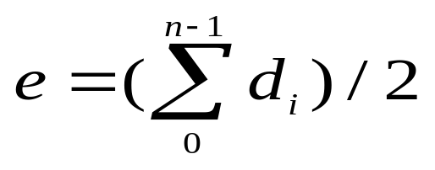
Degree
The degree of a vertex is the number of edges incident to that vertex
For directed graph,
  the in-degree of a vertex v is the number of edges
  that have v as the head
  the out-degree of a vertex v is the number of edges
  that have v as the tail
  if di is the degree of a vertex i in a graph G with n vertices and e edges, the number of edges is
CHAPTER 6

Slide 12
undirected graph
degree
3
0
0
2
1
2
3
1
2
3
3
3
3
4
5
6
3
3
1
G1
1
G2
1
1
0
in:1, out: 1
directed graph
in-degree
out-degree
1
in: 1, out: 2
2
in: 1, out: 0
G3
CHAPTER 6

Slide 13
0
1
2
3
Adjacency matrices
Adjacency lists
G1
0
1
0
4
2
2
1
5
6
G3
3
7
G4
CHAPTER 6

Slide 14
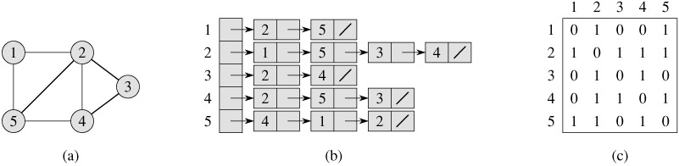
Graph representation – undirected
graph
Adjacency list
Adjacency matrix
ref. Introduction to Algorithms by Thomas Cormen

Slide 15
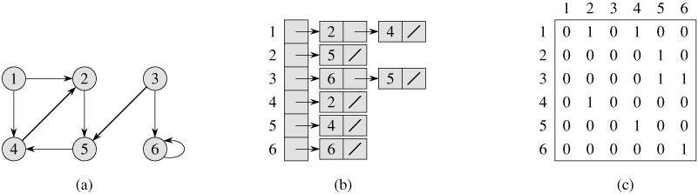
Graph representation – directed
graph
Adjacency list
Adjacency matrix
ref. Introduction to Algorithms by Thomas Cormen

Slide 16
Adjacency Matrix
Let G=(V,E) be a graph with n vertices.
The adjacency matrix of G is a two-dimensional
n by n array, say adj_mat
If the edge (vi, vj) is in E(G), adj_mat[i][j]=1
If there is no such edge in E(G), adj_mat[i][j]=0
The adjacency matrix for an undirected graph is symmetric; the adjacency matrix for a digraph
need not be symmetric
CHAPTER 6

Slide 17
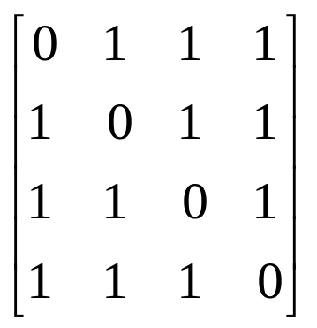
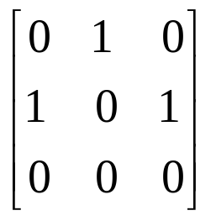
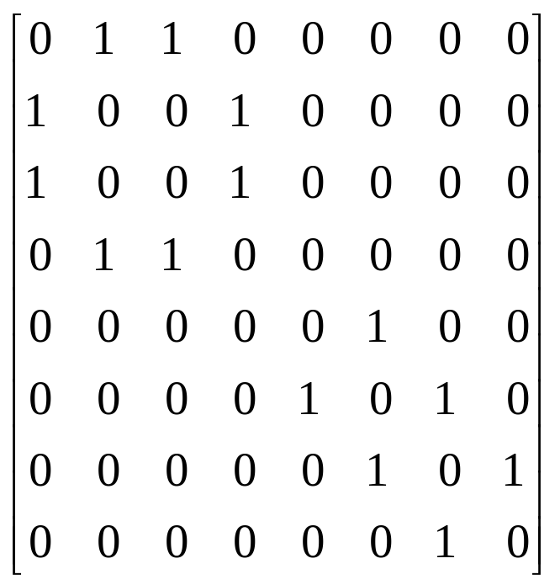
Examples for Adjacency Matrix
0
0
4
0
2
1
5
1
2
3
6
3
1
7
2
G2
G1
symmetric
undirected: n²/2
directed: n²
CHAPTER 6
G4

Slide 18
Adjacency lists
0
1
1
2
0
2
G3
3
1
2
0
2
3
0
1
2
1
3
0
3
0
1
2
G1
CHAPTER 6

Slide 19
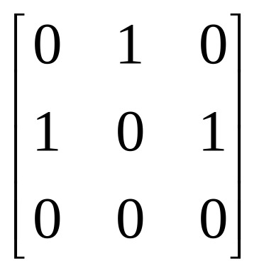
Adjacency lists
0
1
1
2
0
2
G3
CHAPTER 6

Slide 20
Some Graph Operations
Traversal
Given G=(V,E) and source vertex v, find all w∈V,
such that w connects v.
  Depth First Search (DFS)
  preorder tree traversal
  Breadth First Search (BFS)
  level order tree traversal
CHAPTER 6

Slide 21
Depth-first search
A depth-first search (DFS) explores a path all the way to a leaf before backtracking and exploring another path
For example, after searching A, then B, then D, the search backtracks and tries another path from B
Node are explored in the order A B D E H L M N I O P C F G J K Q
A
B
C
D
E
F
G
H
I
J
K
L
M
N
O
P
Q

Slide 22
DFS Algorithm
Mark all the n vertices as not visited.
insert source into stack and mark it visited
while(Stack is not empty)
{
delete Stack element into variable u
place all the adjacent (not visited) vertices of u into Stack and also mark them visited
print u
}

Slide 23
void dfs(int a[20][20],int n,int source)
{ int visited[10],u,v,i;
for(i=1;i<=n;i++) visited[i]=0;
int S[20],top=-1;
S[++top]=source;
visited[source]=1;
while(top>=0)
{
u=S[top--];
for(v=1;v<=n;v++)
{ if(a[u][v]==1 && visited[v]==0)
{
visited[v]=1; S[++top]=v;
}
}
cout<<u<<" ";
}
}

Slide 24
Breadth first search
  It is so named because
  It discovers all vertices at distance k from s before discovering vertices at distance k+1.
ref. Introduction to Algorithms by Thomas Cormen

Slide 25
Breadth-first search
A breadth-first search (BFS) explores nodes nearest the root before exploring nodes further away
For example, after searching A, then B, then C, the search proceeds with D, E, F, G
Node are explored in the order A B C D E F G H I J K L M N O P Q
A
B
C
D
E
F
G
H
I
J
K
L
M
N
O
P
Q

Slide 26
Algorithm BFS
Mark all the n vertices as not visited.
insert source into Q and mark it visited
while(Q is not empty)
{
delete Q element into variable u
place all the adjacent (not visited) vertices of u into Q and also mark them visited
print u
}

Slide 27
void bfs(int a[20][20],int n,int source)
{
int visited[10],u,v,i;
for(i=1;i<=n;i++) visited[i]=0;
int Q[20],f=-1,r=-1;
Q[++r]=source; visited[source]=1;
while(f<r)
{
u=Q[++f];
for(v=1;v<=n;v++)
{ if(a[u][v]==1 && visited[v]==0)
{
visited[v]=1;
Q[++r]=v;
}
}
cout<<u<<" ";
}
}

Slide 28
#include<iostream.h>
void bfs(int a[20][20],int n,int source);
void dfs(int a[20][20],int n,int source);
int main()
{
int a[20][20],source, n,i,j;
cout<<"Enter the no of vertices: "; cin>>n;
cout<<"Enter the adjacency matrix: ";
for(i=1;i<=n;i++) for(j=1;j<=n;j++) cin>>a[i][j];
cout<<"Enter the source: ";
cin>>source;
cout<<"\n BFS: "; bfs(a,n,source);
cout<<"\n DFS: "; dfs(a,n,source);
return 1;
}

Slide 29
Spanning Tree
A spanning tree is a acyclic subgraph G’, such that V(G’)=V(G) and G’ is connected. Spanning Tree is always acyclic.
3
1
2
0
2
3
0
1
2
1
3
0
0
0
3
0
1
2
1
2
1
2
G1
3
3
CHAPTER 6

